Slide 1
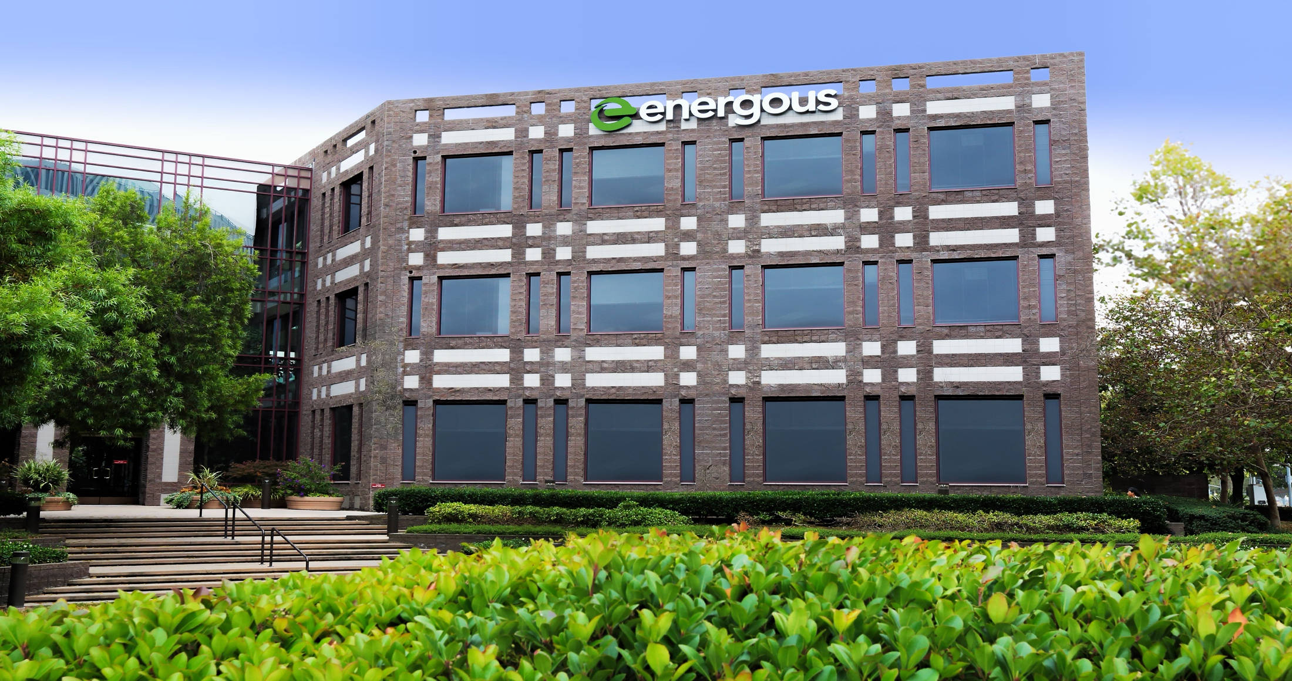
August 2016
UNLEASH YOUR POWER®

Slide 2
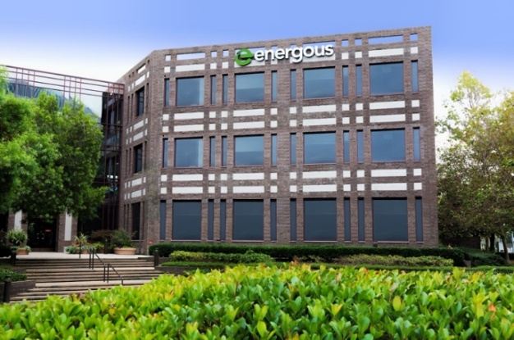
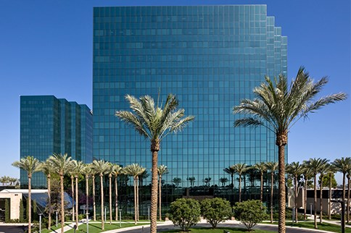
ENERGOUS AT A GLANCE
Unleash Your Power
CORPORATE HEADQUARTERS
3590 N 1st Street, Suite 210
San Jose, CA 95134
RF-Based Wireless Charging:
Silicon, Antenna and Software
Tier-1 OEM & Leading Partner Engagements Underway
250+ pending U.S. Patents and Provisional Patent Applications
Expansive Technology and Chip Design Experience
Team: 80% Engineering – 75% Advanced Degrees
IPO in March 2014 on NASDAQ (Stock Symbol: WATT)
SOUTHERN CALIFORNIA OFFICE
3200 Park Center Drive, Suite 380
Costa Mesa, CA 92626

Slide 3
ENERGOUS PROGRESS
Highlights from 2016 & 2015
ENERGOUS 2016
FCC approval granted for Mini WattUp® transmitter solution.
Partnership announced with Pegatron.
Nearing mass production for our first FCC-approved product.
Expansion of agreement with our Tier-1 key strategic partner.
Total allowed and issued patents now number 16
7 BEST IDEAS FROM CES 2016
“Wireless charging has been a CES tech demo for years. But Energous may be the first company to make the idea practical…the technology is small enough, smart enough, and powerful enough to make a big impact in the near future.”– Mark Wilson
ENERGOUS 2015
6-time award winner at CES 2015, including Best of CES 2015 from Engadget.
Marty Cooper, “Father of The Cell Phone” joins Energous Corporation Board of Directors
Signed a Tier-1 consumer electronics licensee
Secured over $2M in revenue, ahead of projections
Received the first 6 patents from the USPTO in October 2015
Announced availability of world’s first RF power receive chip

